Slide 1
LAW OF DEMAND

Slide 2
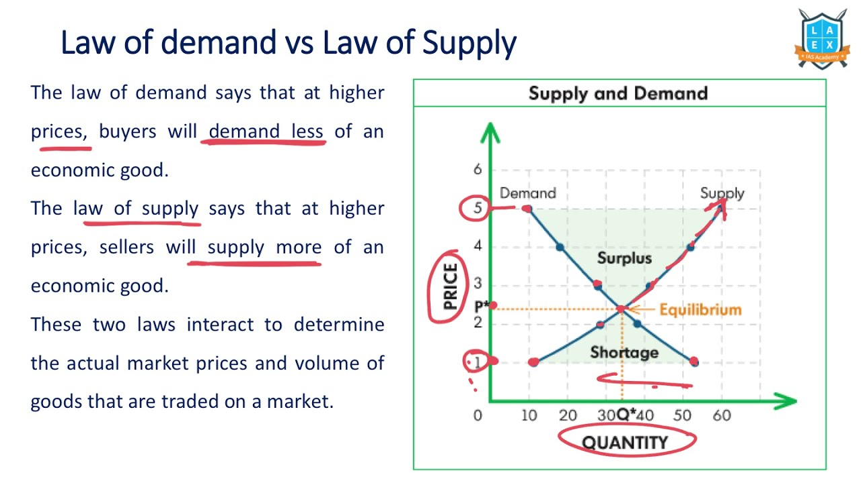
Introduction to the Law of Demand
The Law of Demand states that, all else being equal, as the price of a good decreases, the quantity demanded increases.
Conversely, as the price increases, the quantity demanded decreases.
This fundamental principle is essential for understanding consumer behavior in economics.
Notes:
Image source: https://i.ytimg.com

Slide 3
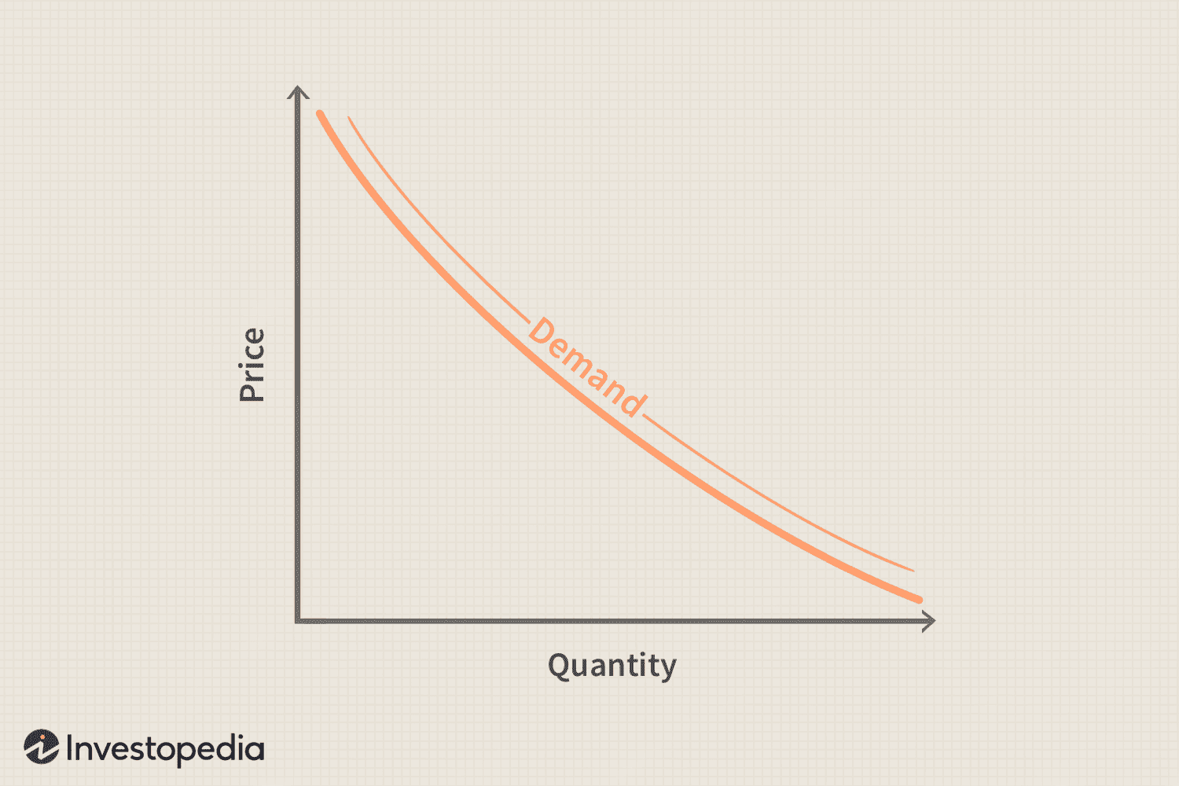
Understanding Demand
Demand refers to the quantity of a good or service that consumers are willing and able to purchase at various price levels.
It is influenced by various factors, including consumer preferences, income levels, and the prices of related goods.
Demand is represented graphically as a downward-sloping curve on a price-quantity graph.
Notes:
Image source: https://www.investopedia.com

Slide 4
The Demand Curve
The demand curve illustrates the relationship between price and quantity demanded.
It typically slopes downward from left to right, reflecting the inverse relationship outlined in the Law of Demand.
Each point on the curve represents a specific price-quantity combination for a particular good.
Notes:
Image source: https://www.investopedia.com

Slide 5
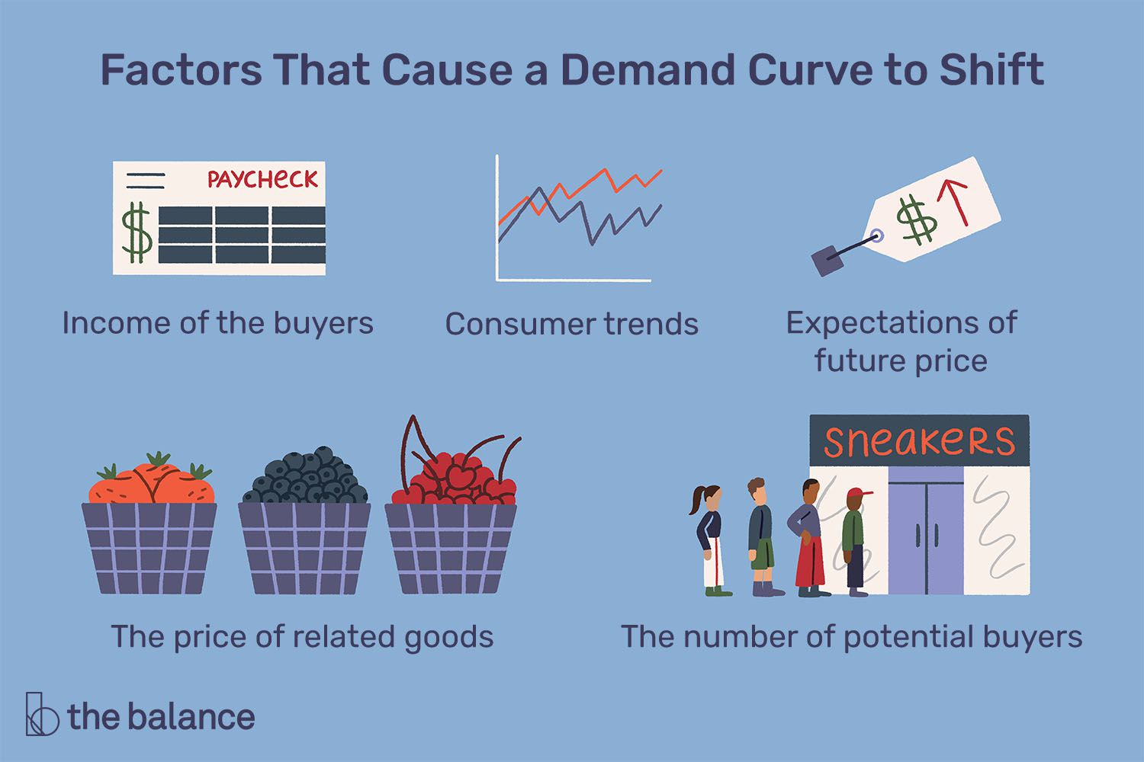
Factors Affecting Demand
Several factors can shift the demand curve, including changes in consumer income and preferences.
The prices of related goods, such as substitutes and complements, also play a crucial role in demand fluctuations.
Seasonal changes and demographic shifts can further influence demand for certain products.
Notes:
Image source: https://www.thebalancemoney.com

Slide 6
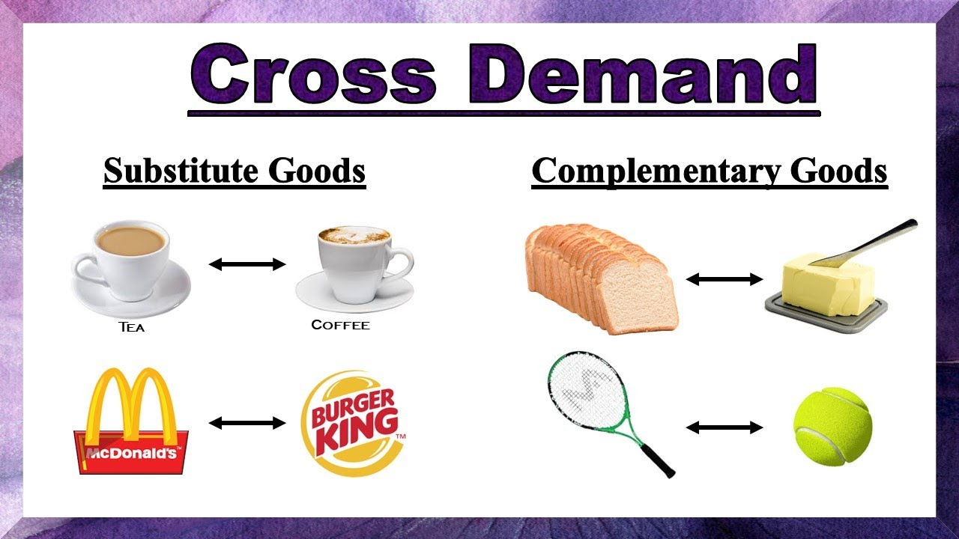
Substitutes and Complements
Substitute goods are those that can replace each other, meaning that an increase in the price of one can lead to an increase in demand for the other.
Complementary goods are those that are used together; if the price of one rises, the demand for the other may decrease.
Understanding these relationships is vital for businesses in pricing and marketing strategies.
Notes:
Image source: https://i.ytimg.com

Slide 7
Elasticity of Demand
Elasticity of demand measures how responsive the quantity demanded is to a change in price.
Demand can be classified as elastic, inelastic, or unitary depending on consumer responses to price changes.
This concept helps businesses and policymakers make informed decisions regarding pricing and production.
Notes:
Image source: https://www.slidemake.com

Slide 8
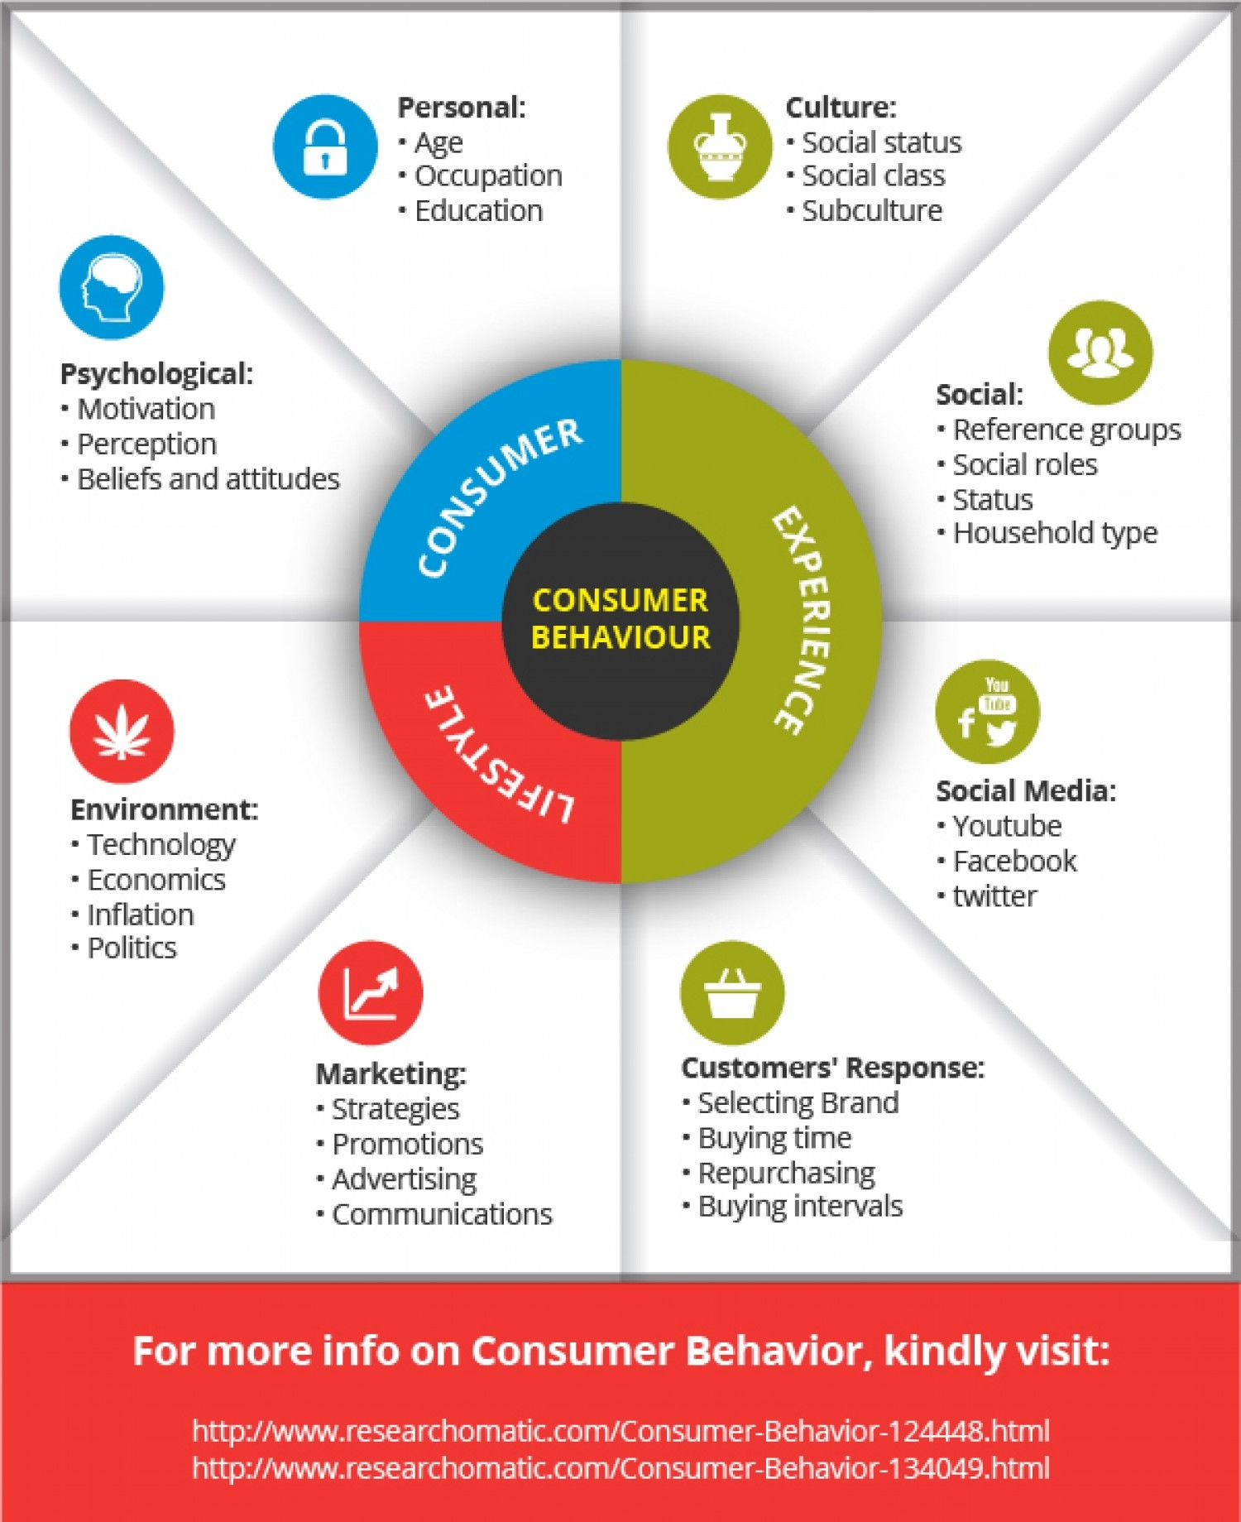
The Role of Consumer Preferences
Consumer preferences significantly impact demand as they shape the desirability of various goods and services.
Changes in trends, advertising, and social influences can shift preferences rapidly.
Businesses must adapt to these shifts to maintain and grow their market share.
Notes:
Image source: https://i.pinimg.com

Slide 9
Real-World Applications
The Law of Demand has practical implications for businesses in setting prices and managing inventory.
Policymakers use demand analysis for taxation and subsidy decisions to achieve economic goals.
Understanding demand helps in predicting market trends and consumer behavior.
Notes:
Image source: https://www.researchgate.net

Slide 10
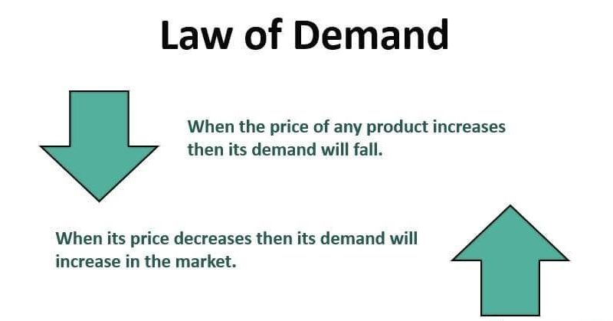
Limitations of the Law of Demand
The Law of Demand assumes that all other factors remain constant, which is not always the case in the real world.
Exceptions, such as Giffen and Veblen goods, challenge traditional demand theory.
Understanding these limitations is critical for a nuanced approach to economic analysis.
Notes:
Image source: https://www.valuerworld.com

Slide 11
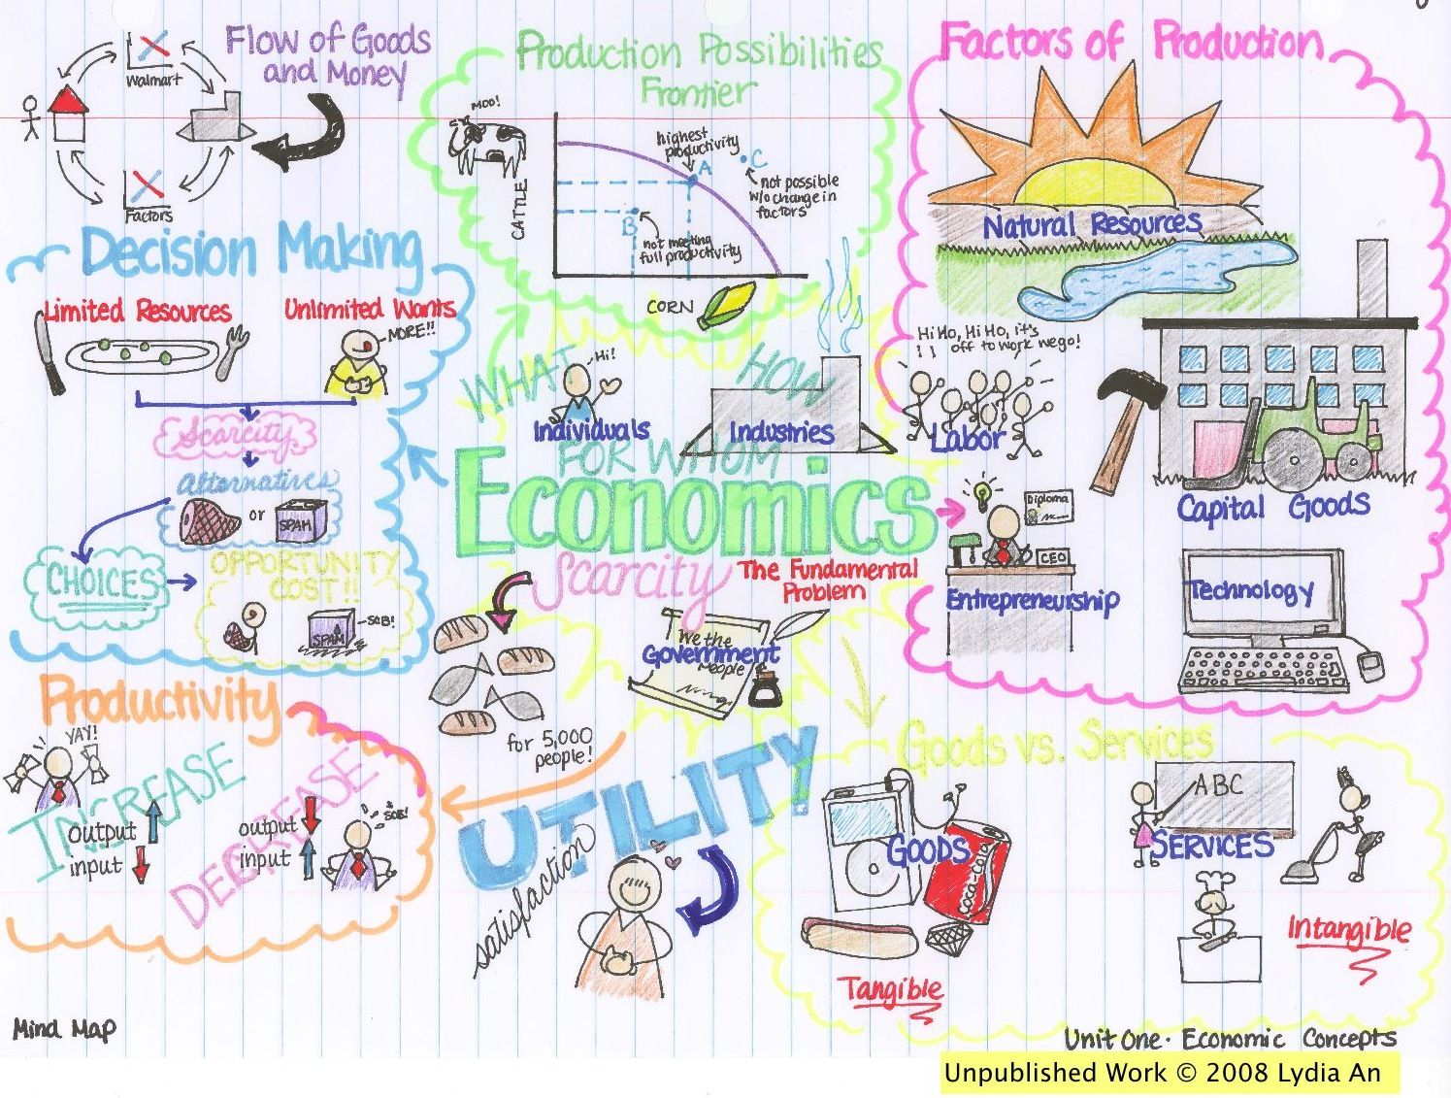
Conclusion
The Law of Demand is a fundamental concept in economics that illustrates consumer behavior related to price changes.
It serves as a foundation for understanding market dynamics and the interplay between supply and demand.
A thorough grasp of this law is essential for anyone involved in economic analysis, business strategy, or policymaking.
Notes:
Image source: https://i.pinimg.com

